Slide 1

DAYANANDA SAGAR UNIVERSITY
SCHOOL OF ENGINEERING
Department of Computer Science and Engineering
(Artificial Engineering & Machine Learning)
SMART TRAFFIC MANAGEMENT AND ACCIDENT PREVENTION
As part of the
course : DEEP LEARNING
Course Code: 22AM3602
Presented By:
Kushal Gowda H M (ENG22AM0029)
M Nandini (ENG22AM0030)
Mahesh K S (ENG22AM0032)
Rathastha G D (ENG22AM0048)
Under the guidance of
Dr Abdul Haq Nalband
Associate Professor, Dept. of CSE (AI & ML)
Notes:
Title of the project
CSE Dept., SET-Jain University

Slide 2
Overview
Abstract
Problem Statement
Introduction
Social/Environmental Impact
Design/Methodology
Implementation
Result and Analysis
Conclusion
References
Dept of CSE (AI & ML)., SOE-Dayananda Sagar University

Slide 3
Abstract
Smart traffic management leverages advanced technologies such as AI, IoT, computer vision, and big data to optimize urban traffic flow and enhance road safety.
The system enables real-time monitoring and control of traffic signals, vehicle movements, and road conditions to reduce congestion and travel time.
Accident prevention mechanisms include collision detection systems, speed monitoring, pedestrian tracking, and AI-based surveillance for rule violation alerts.
Connected infrastructure and vehicle-to-everything (V2X) communication allow proactive response to potential hazards and better coordination between vehicles and traffic control centers.
Dept of CSE (AI & ML)., SOE-Dayananda Sagar University

Slide 4
Problem Statement
Problem: "Urban areas are facing increasing challenges due to rapid population growth and rising numbers of vehicles on the roads. This has resulted in severe traffic congestion, longer commute times, increased pollution, and a high number of road accidents."
Solution: "Develop an AI-powered system using YOLOv8 to monitor traffic in real-time through video feeds . Implement smart vehicle detection, density estimation, and accident identification using deep learning .Provide automated alerts to traffic authorities in case of accidents or violations . Enable data-driven traffic management to optimize flow and enhance urban mobility” .
Dept of CSE (AI & ML)., SOE-Dayananda Sagar University

Slide 5
Introduction
Urbanization and population growth have led to an exponential increase in the number of vehicles on roads.
Traditional traffic management systems are rigid, inefficient, and unable to handle real-time changes in traffic flow.
Road congestion causes delays, fuel wastage, increased emissions, and economic losses.
Road accidents are a major concern, leading to injuries, fatalities, and property damage, often due to human error or lack of timely intervention.
Dept of CSE (AI & ML)., SOE-Dayananda Sagar University

Slide 6
Social/Environmental Impact
Improves road safety by enabling early accident detection and real-time
alerts.
Ensures faster emergency response, reducing fatalities and injuries.
Assists in automated traffic law enforcement and evidence generation.
Supports smart city development through AI-powered infrastructure.
Reduces fuel consumption and emissions by minimizing traffic congestion.
Contributes to cleaner air and better urban mobility.
Dept of CSE (AI & ML)., SOE-Dayananda Sagar University

Slide 7
Design/Methodology
Sensors & Cameras: Install IoT devices to collect real-time traffic and accident data.
Edge & Cloud Processing: Process data locally for quick actions and centrally for analysis.
AI Traffic Analysis: Use machine learning to predict congestion and traffic patterns.
Smart Signals: Implement adaptive traffic lights based on real-time flow.
Accident Detection: Use computer vision to detect accidents and violations instantly.
V2X Communication: Enable vehicles to communicate with infrastructure for alerts.
Dept of CSE (AI & ML)., SOE-Dayananda Sagar University

Slide 8
Implementation
Developed using YOLOv8 for real-time object detection from traffic surveillance video.
Integrated Python, OpenCV, and Ultralytics YOLO framework for model training and deployment.
Trained on a custom dataset with annotated traffic and accident scenarios.
Detected vehicles, violations, and accidents with high confidence in real-world test videos.
Dept of CSE (AI & ML)., SOE-Dayananda Sagar University

Slide 9
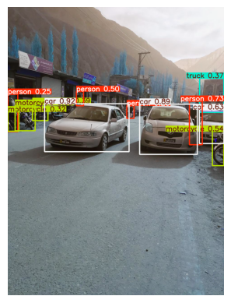
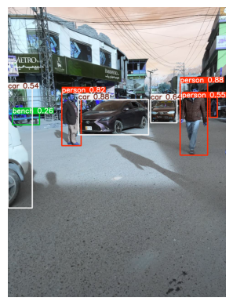
Result and Analysis
Detects the objects in the image for smart traffic management
Dept of CSE (AI & ML)., SOE-Dayananda Sagar University

Slide 10
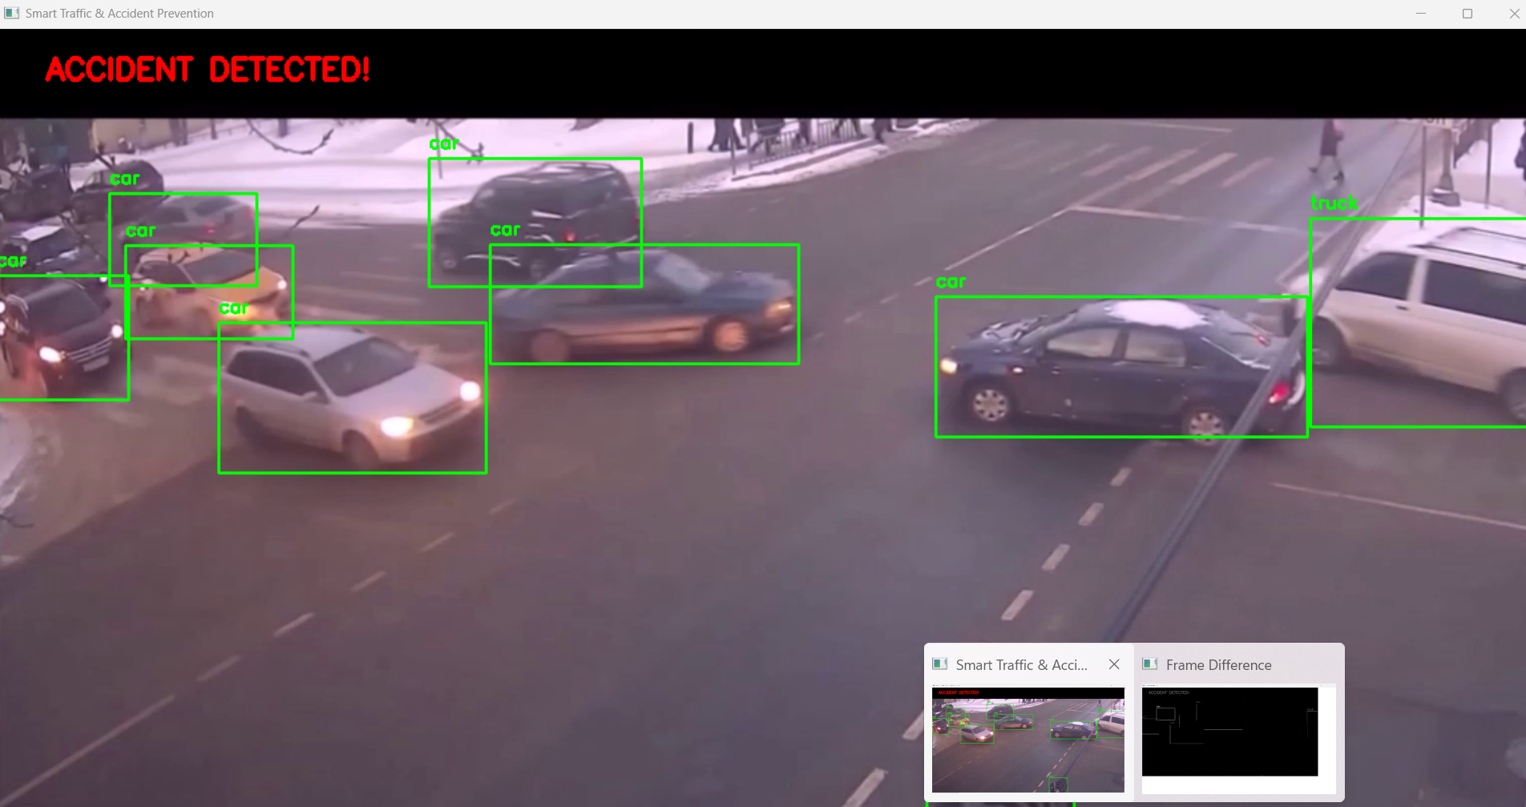
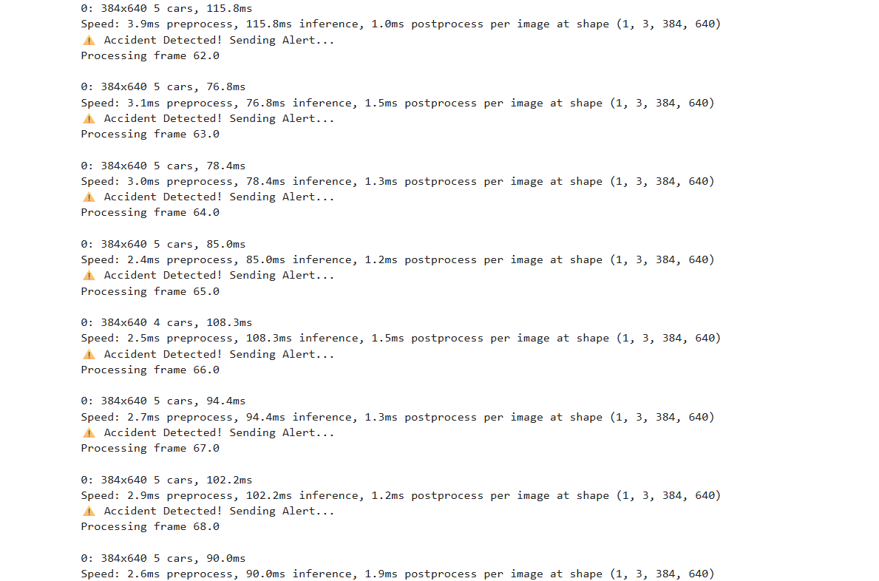
Result and Analysis
Accident Detection: Real-time system detects vehicle collisions using object detection (YOLO).
Alert System: Sends automatic alerts upon detecting accidents.
Efficient Processing: Processes each frame quickly for real-time monitoring.
Dept of CSE (AI & ML)., SOE-Dayananda Sagar University

Slide 11
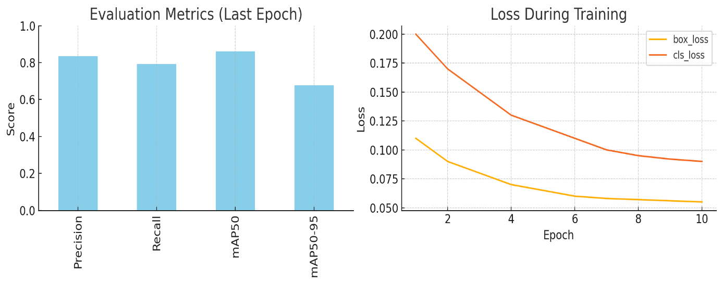
Result and Analysis
Metrics Used:
System demonstrated real-time inference at ~30 FPS on standard GPU/CPU setups.
Inference Speed | Real-time (30 FPS) | Real-time (30 FPS)
Precision | 83.5% | 83.5%
Recall | 79.2% | 79.2%
mAP@0.5:0.95 | 67.8% | 67.8%
mAP@0.5 | 86.1% | 86.1%
Model | YOLOv8 | YOLOv8
Dept of CSE (AI & ML)., SOE-Dayananda Sagar University

Slide 12
Conclusion
YOLOv8 (You Only Look Once v8) is a state-of-the-art real-time object detection model, ideal for traffic monitoring applications.
Real-Time Vehicle and Pedestrian Detection: YOLOv8 can accurately detect cars, buses, bikes, and pedestrians from live traffic camera feeds.
Traffic Violation Monitoring: It helps identify traffic rule violations such as red-light jumping, illegal turns, and lane violations.
Accident Detection and Response: YOLOv8 can be trained to detect crashes or abnormal behavior on roads, triggering immediate alerts for emergency services.
Dynamic Traffic Signal Control: By analyzing traffic density and vehicle flow, YOLOv8 enables adaptive signal timing to reduce congestion.
Smart Parking Management: It can detect vacant and occupied parking spots in real time, improving urban parking systems.
Dept of CSE (AI & ML)., SOE-Dayananda Sagar University

Slide 13
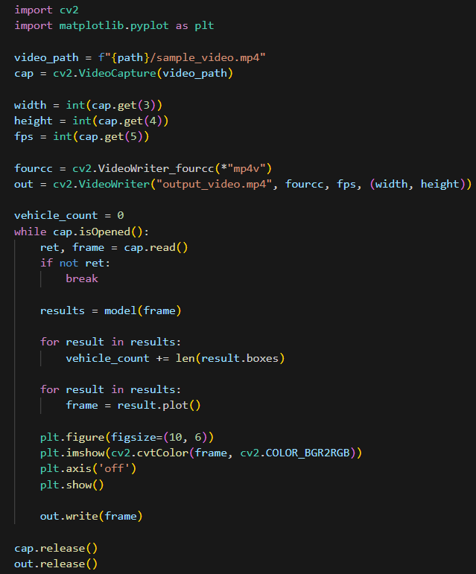
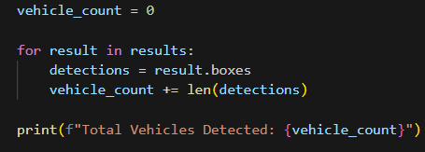
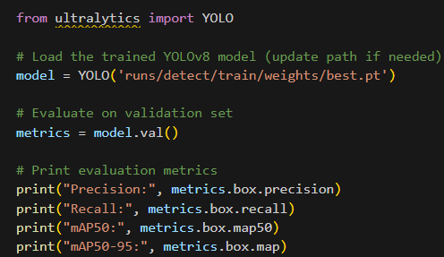
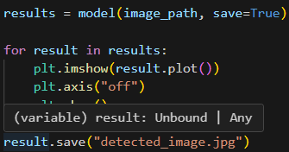
Project Code
Dept of CSE (AI & ML)., SOE-Dayananda Sagar University

Slide 14
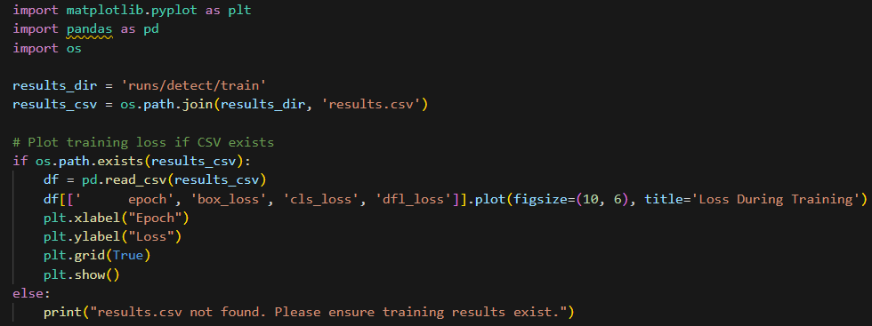
Dept of CSE., SOE-Dayananda Sagar University

Slide 15
References
Wang, Y., et al. (2020). Smart traffic management system: A review. IEEE Access, 8, 171984–172004. doi:10.1109/ACCESS.2020.3024205
Zheng, N., et al. (2016). Hybrid intelligent system for traffic accident prediction. IEEE Transactions on Intelligent Transportation Systems, 17(6), 1527–1531. doi:10.1109/TITS.2015.2496871
Yaseen, M. et al. (2022). IoT-based smart traffic signal control system for smart cities. Journal of Ambient Intelligence and Humanized Computing, 13, 1495–1507. https://doi.org/10.1007/s12652-021-03055-9
National Highway Traffic Safety Administration (NHTSA). (2021). Vehicle-to-Infrastructure (V2I) Communications for Safety. Retrieved from: https://www.nhtsa.gov/
ITU-T FG-ITS (International Telecommunication Union - Focus Group on Intelligent Transport Systems). (2017). Smart traffic control standards and recommendations. Retrieved from: https://www.itu.int
Dept of CSE (AI & ML)., SOE-Dayananda Sagar University

